Slide 1

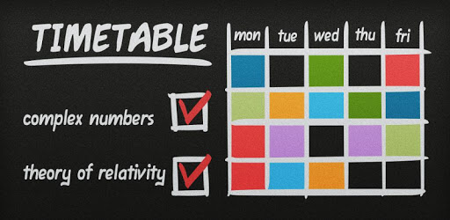

COURSE TIMETABLING
CS-254
Design & Analysis of Algorithm
Problem statement and
solution proposal
Neeraj Verma (170005020)
Dhruv Singhal (170001022)

Slide 2
Outline
The Problem
Solution Proposal
Algorithms
Analysis
Comparison

Slide 3
The Problem
To construct a timetable for University/School.
Realistic timetable construction problems are multidimensional because of large diversity in acceptance criteria.
Only heuristic solution approaches are practically possible.

Slide 4
Assumptions
Design a course timetable with :
‘P’ periods in a day
‘D’ days in a week
‘N’ subjects
‘R’ professors
Maximum periods for S_{i} is X_{i}
Maximum periods for P_{i} is Y_{i}
Many to one mapping for P to S
No two subjects are placed together

Slide 5
Solution Proposal
Following approaches are used to solve the problem :-
GENETIC ALGORITHM
ANT COLONY OPTIMISATION

Slide 6
Solution description
GENETIC ALGORITHM
Based on the principles of Genetics and Natural Selection.
Survival of the fittest.
Start with a pool or a population of possible solutions.
These solutions undergo recombination and mutation.
Produce fitter next generation.
The fitter individuals are given higher chance to mate and yield “fitter” offspring.
Keep “evolving” better individuals or solutions over generations.
Repeat until target is reached.

Slide 7
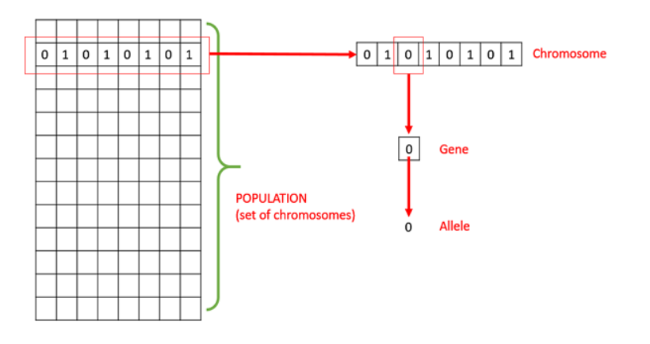
Basic Terminology
GENETIC ALGORITHM
Population : It is a subset of all the possible solutions to the given problem.
Chromosomes : One such solution to the given problem.
Gene : One element position of a chromosome.
Allele : It is the value a gene takes for a particular chromosome.

Slide 8
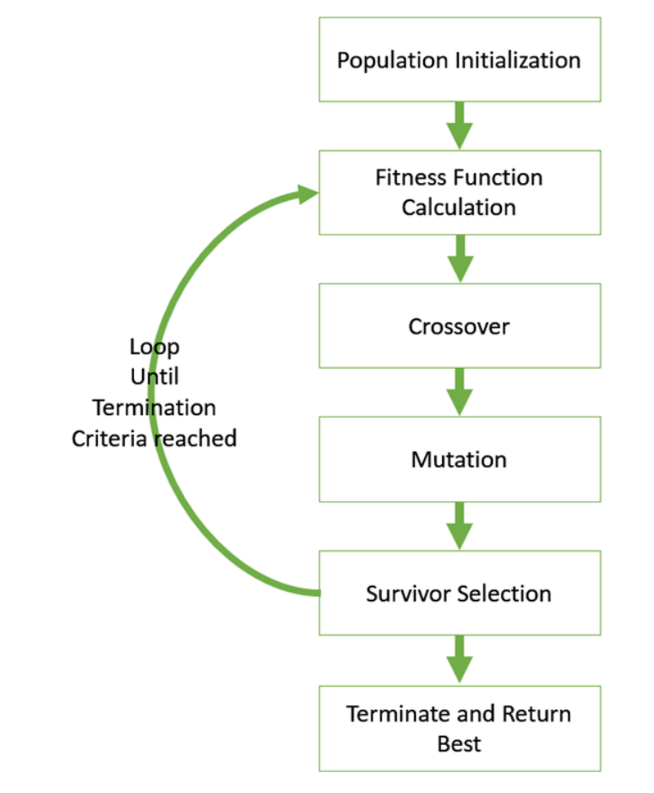
Basic Structure
GENETIC ALGORITHM
Start with an initial population (random/heuristic).
Select parents for mating.
Apply crossover and mutation on the parents to generate new off-springs.
These off-springs replace the existing individuals in the population.

Slide 9
Generalised Pseudo-code
GENETIC ALGORITHM
GA()
initialize population
find fitness of population
while (termination criteria is reached) do
parent selection
crossover with probability pc
mutation with probability pm
decode and fitness calculation
survivor selection
find best
return best

Slide 10
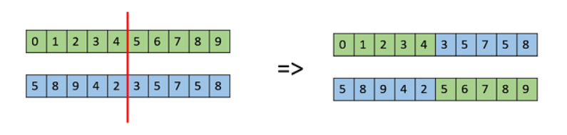
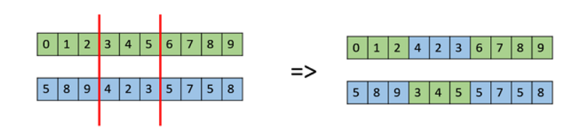
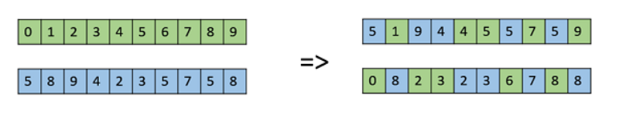
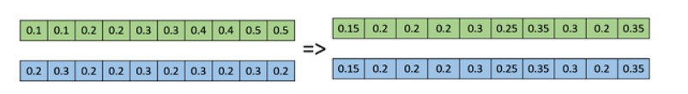
Crossover Operators
GENETIC ALGORITHM
One Point Crossover
Multi Point Crossover
Uniform Crossover
Whole Arithmetic Recombination

Slide 11




Mutation Operators
GENETIC ALGORITHM
Bit Flip Mutation
Swap Mutation
Scramble Mutation
Inverse Mutation

Slide 12
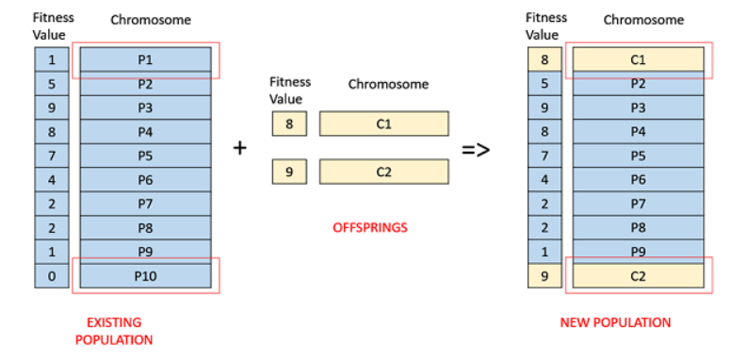
Fitness Based Selection
GENETIC ALGORITHM
Children tend to replace the least fit individuals in the population.

Slide 13
Terminating Condition
GENETIC ALGORITHM
When there has been no improvement in the population for X iterations.
When we reach an absolute number of generations.
When the objective function value has reached a certain pre-defined value.

Slide 14
Application in course timetabling
GENETIC ALGORITHM
Assuming total Subjects=6, Professors=3, Periods in a day=6, Days in a week=5
Denote Subjects with ‘A’,’B’,’C’,’D’,’E’ & ‘F’ respectively.
Target is to create a string of length 30, with the given constraints.
Begin with a pool of 100 strings of length 30 each.
Apply Genetic Algorithm on these to find fitter population.
The individual satisfying terminating condition is the final answer.

Slide 15
Problem statement
State the problem you are solving in one or two sentences.
Make sure to explain why it is a real problem.

Slide 16
What customers do today
Justify your effort to try to solve the problem.
Highlight the pain points of the current solution or how customers deal with not having a solution to the problem.

Slide 17
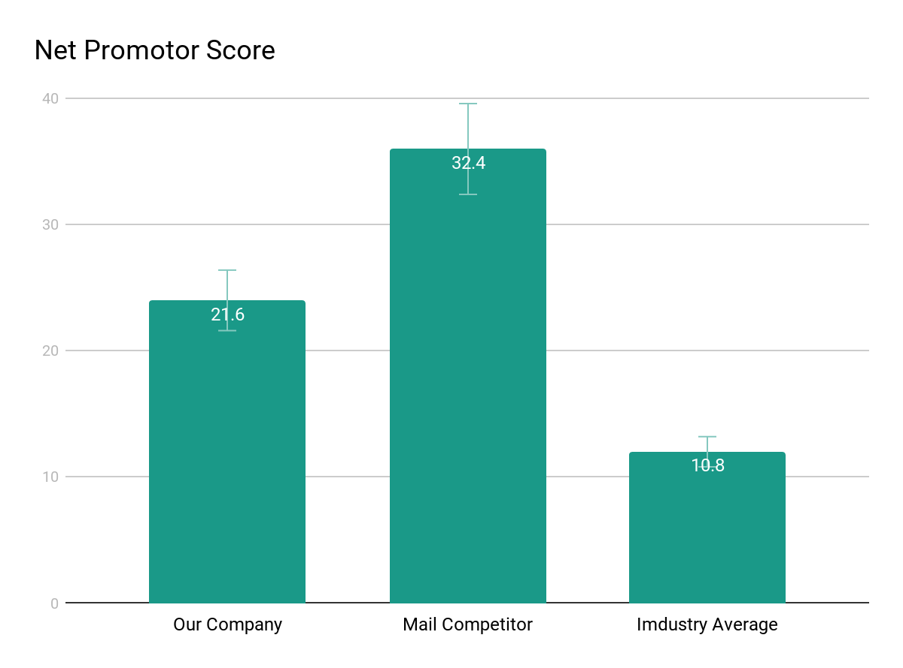
Supporting information
01
1
List any research or data you have to support the need for a solution.

Slide 18
Supporting information
02
82%
Users are constantly searching for a solution
Explain why you’re focusing on a particular part of the problem or a particular subset of users.

Slide 19

Supporting information
03
Julia
Team Manager
Reference your personas, if you have them.
Describe the content of Julia’s job and the problem she and her team are currently facing.

Slide 20
Use cases / user stories
Use cases, user stories, notes to set up the wireframes. Such as…
“As an Administrator, I would like to restrict permissions based on role.”
“As a Moderator, I would like to flag and approve comments.”
Executives indicated that being able to see a summary of each segment of data was their #1 priority.
Note: secondary admin workflow not planned for this release.

Slide 21
Why it’s better than existing solutions
Return to the problem now that you’ve introduced your solution. Compare your solution to others and describe how it is superior.

Slide 22
Wireframes

Slide 23
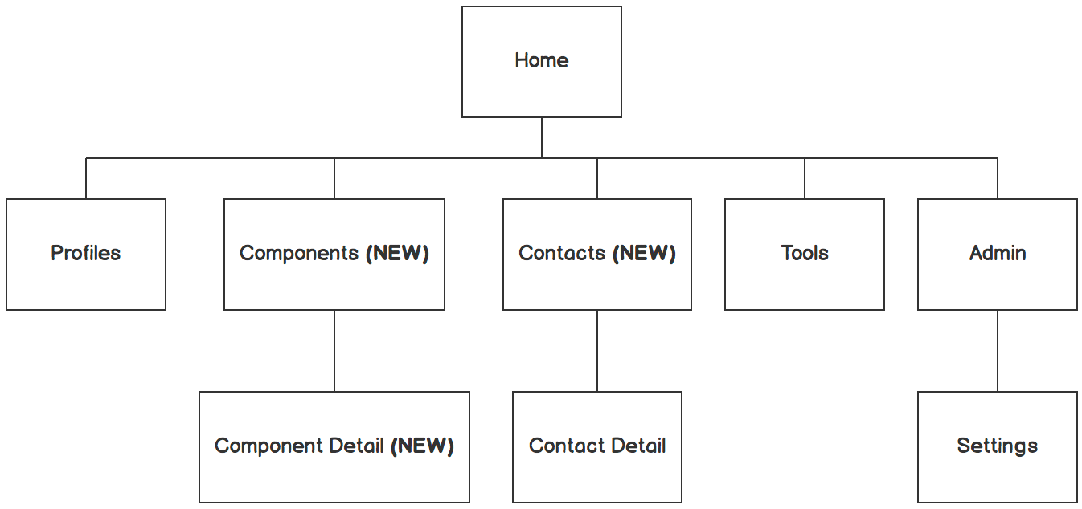

Information architecture
Balsamiq Tip | Information architecture is the flow of content across the site or application (more info).

Slide 24
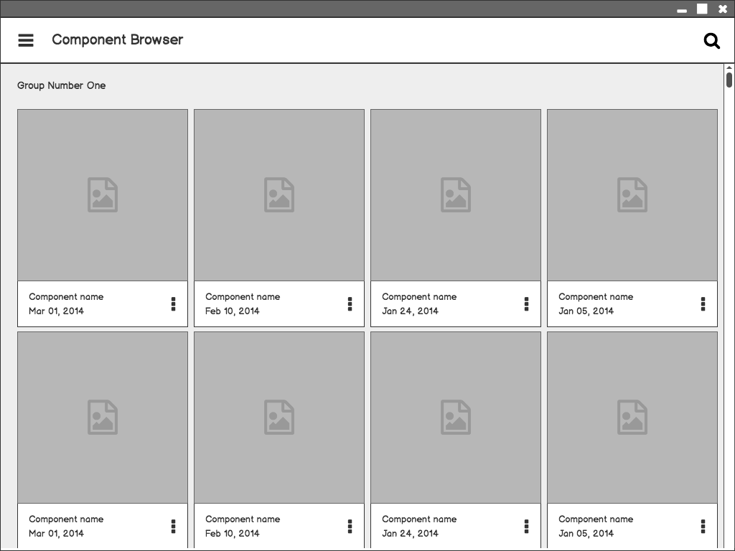
Component Browser
Call out key parts of the UI
Balsamiq Tip | Use the Balsamiq add-on to make your own wireframe.

Slide 25

Component Detail

Slide 26

Component Detail (Mobile)
Articulate your design decisions by adding justifications

Slide 27
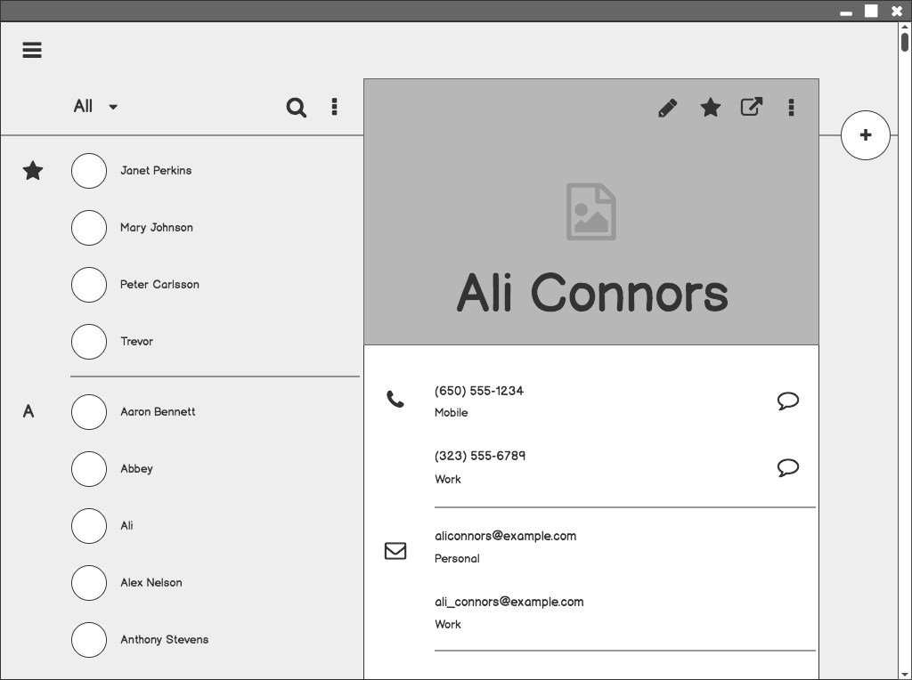
Contacts

Slide 28
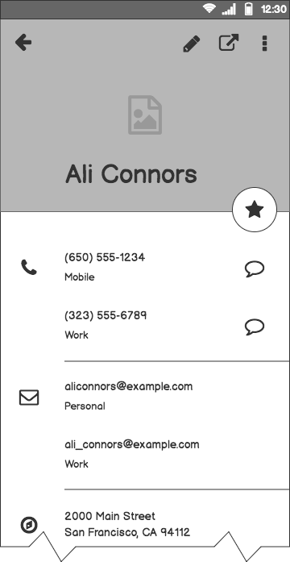
Contacts (Mobile)

Slide 29
Next Steps

Slide 30
What next?
Present the timeline.
Solicit comments on these slides or reviews on these wireframes in the Balsamiq add-on.
User testing plan.

Slide 31
Timeline
MAY
JUN
TODAY
AUG
SEPT
OCT
NOV
Requirements gathering
User research
Wireframes
Review
Prototype
User testing
Dev hand-off

Slide 32
Questions?

Slide 33
References
Tips for Presenting Your Wireframes
3 Steps to Better UI Wireframes
Wireframing for Beginners

